Slide 1





PERFORMANCE BASELINE METRICS
Project: Coke
Site: dunkinanytime.coca-cola.com
SOFTWARE DEVELOPMENT
TEST ENGINEERING
DATA & ANALYTICS

Slide 2

Terminologies
The First Contentful Paint (FCP) metric measures the time from when the page starts loading to when any part of the page's content is rendered on the screen. For this metric, "content" refers to any web elements.
Largest Contentful Paint (LCP) is an user-centric metric for measuring perceived load speed because it marks the point in the page load timeline when the page's main content has likely loaded—a fast LCP helps reassure the user that the page is useful. It reports the render time of the largest image or text block visible within the viewport.
The Speed Index is the average time at which visible parts of the page are displayed. It is expressed in milliseconds and dependent on size of the view port. It measures how quickly the page contents are visually populated.
The DOM Content Loaded event fires when the initial HTML document has been completely loaded and parsed, without waiting for stylesheets, images, and sub frames to finish loading.
The Fully Loaded Time is the point after the Onload event fires and there has been no network activity for 2 seconds.

Slide 3
Analysis Details
Site: https://dunkinanytime.coca-cola.com/
Page: Home Page
Location: US
Network Speed: 90-100 Mbps
Analysis: V1 tags enabled and V1 Tags disabled
Page Load Time and various metrics
Load Time Analysis of each element type
Tools Used to measure Load Time:
WebPageTest
Chrome Developer Tool
Tools Used for Recommendations:
Page Speed Insights
WebPageTest
KeyCDN
3

Slide 4
Performance Metrics
V1 Tags Enabled
V1 Tags Disabled
Metrics | Load Time (Secs)
First Contentful Paint | 1.40
Large Contentful Paint | 5.3
DOM Complete | 5.5
Fully Loaded | 7.8
V1 Tags | 0.62
Metrics | Load Time (Secs)
First Contentful Paint | 1.5
Large Contentful Paint | 5.4
DOM Complete | 5.5
Fully Loaded | 7.8
Metrics | Load Time (Secs) | Size in KB
CSS | 1.2 | 95
JS | 7.7 | 801
HTML | 3.1 | 35
Image | 8.3 | 583
Font | 1.3 | 103
Metrics | Load Time (Secs) | Size in KB
CSS | 1.19 | 95
JS | 8.4 | 800
HTML | 3.5 | 35
Image | 8.5 | 577
Font | 0.9 | 103
4

Slide 5
Load Time Vs Size - V1 Tags Enabled

Slide 6
Load Time Vs Size - V1 Tags Disabled

Slide 7
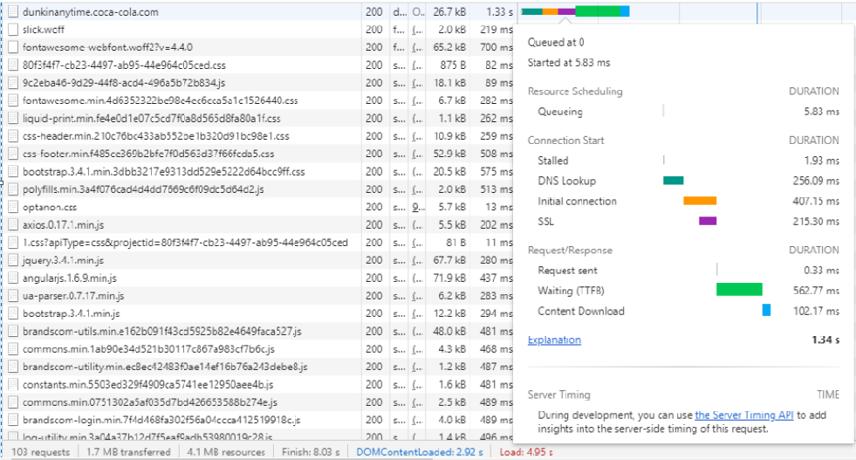
First Document Request Load Time
Time to first byte (TTFB) is a metric for determining the responsiveness of a web server. It measures the amount of time between creating a connection to the server and downloading the contents of a web page.
Average TTFB: 0.3 secs

Slide 8
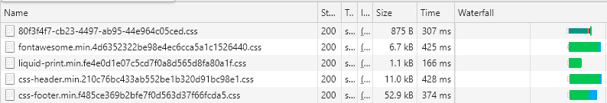
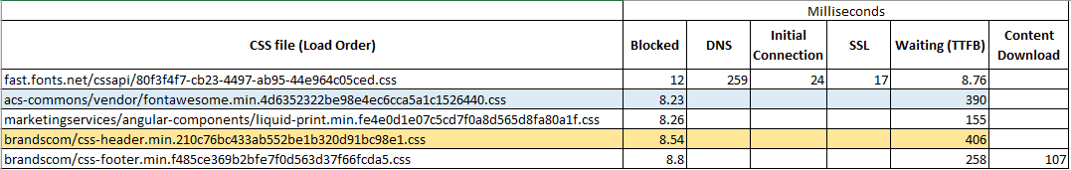
Performance Analysis on CSS files
CSS Average Load Time : 1.2 secs
Total No. of CSS files loading in Home Page : 8
Top files consuming high Load Time : Screenshot and analysis given below

Slide 9
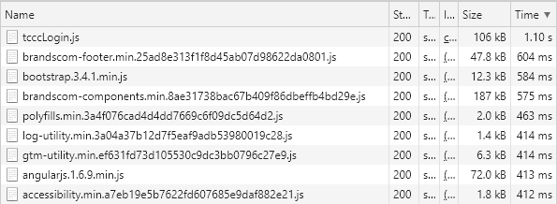
Performance Analysis on JS files
JS Average Load Time : 7.7 secs
Total No. of JS files loading in Home Page : 26
Top files consuming high Load Time : Screenshot given below

Slide 10
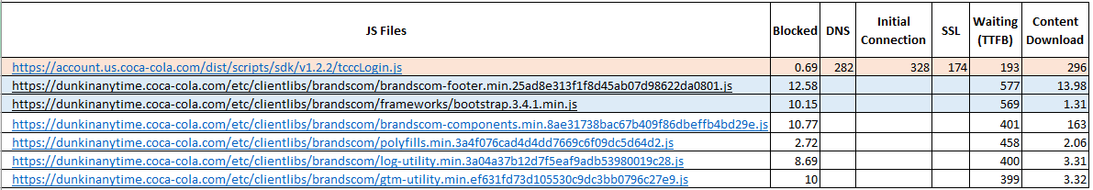
Performance Analysis on JS files
Breakdown Analysis

Slide 11
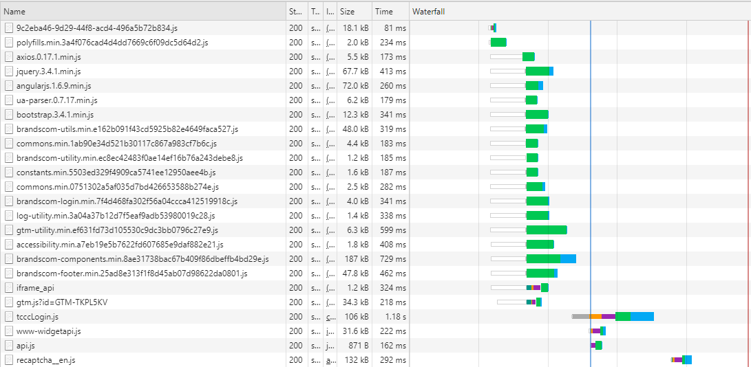
Performance Analysis on JS files
Breakdown Analysis
Sorted by Load order

Slide 12
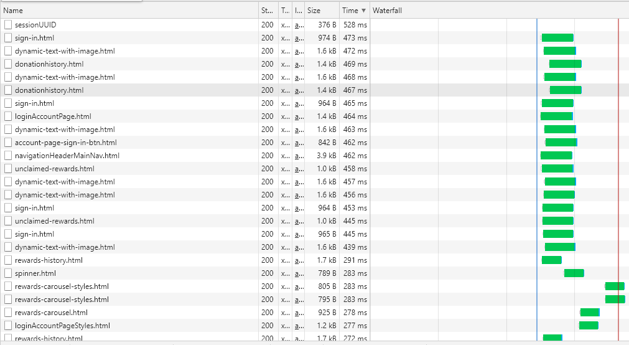
Performance Analysis on HTML files
HTML Average Load Time : 3.1 secs
Total No. of HTML files loading in Home Page : 37
Sorted by High load time

Slide 13
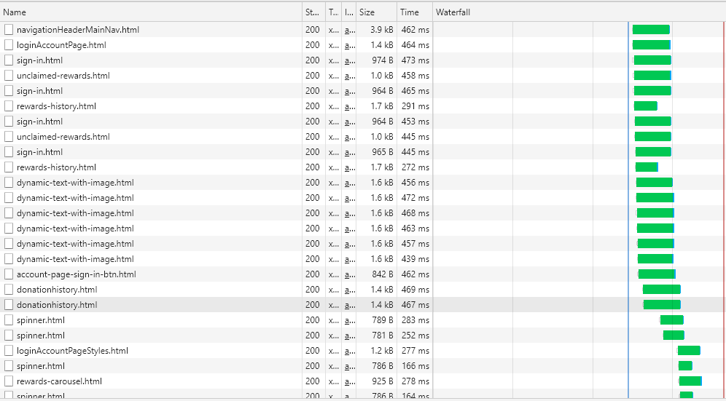
Performance Analysis on HTML files
Wait Time is too high for these requests
Sorted by load Order

Slide 14
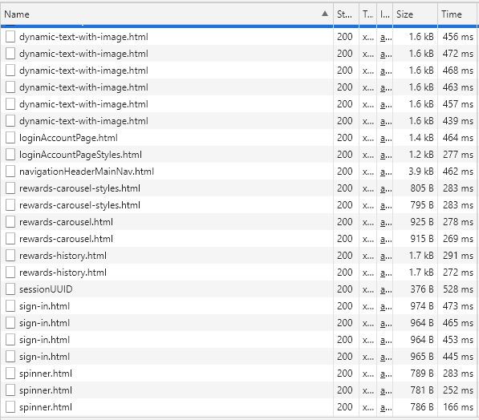
Duplicated XHR requests
Sorted by Request Names

Slide 15
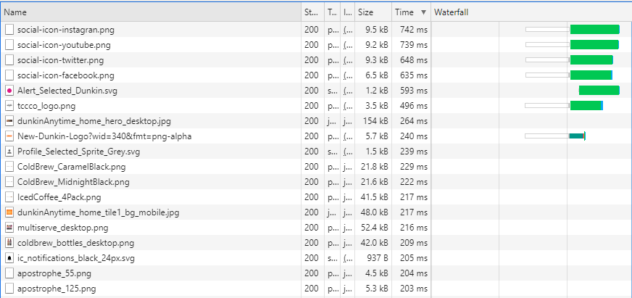
Performance Analysis: IMAGE files
Image Average Load Time : 8.3 secs
Total No. of Image files loading in Home Page : 27
Sorted by High Load Time

Slide 16
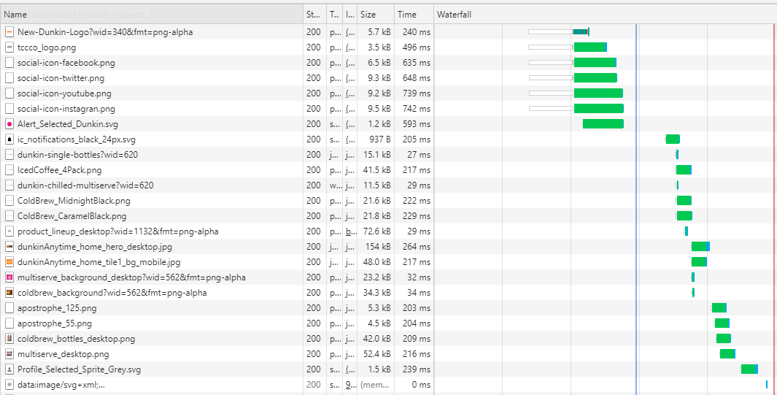
Performance Analysis: IMAGE files
Queue time and Wait time is high
Sorted by Load Order

Slide 17
Recommendations
Leverage Browser Caching: Efficient Cache Policy required
This rule triggers when the response from your server does not include caching headers or if the resources are specified to be cached for only a short time. Fetching resources over the network is both slow and expensive: the download may require multiple roundtrips between the client and server, which delays processing and may block rendering of page content, and also incurs data costs for the visitor. All server responses should specify a caching policy to help the client determine if and when it can reuse a previously fetched response.
URL | Cache TTL
https://fast.fonts.net/dv2/14/0332ed9f-9ff8-46b3-b7a0-b3ebed81de3e.woff2?&projectId=80f3f4f7-cb23-4497-ab95-44e964c05ced | 0
https://account.us.coca-cola.com/dist/scripts/sdk/v1.2.2/tcccLogin.js | 0
https://dunkinanytime.coca-cola.com/etc/clientlibs/acs-commons/vendor/fontawesome/fonts/fontawesome-webfont.woff2?v=4.4.0 | 5 m
https://www.google.com/recaptcha/api.js | 5 m
https://www.google-analytics.com/plugins/ua/ec.js | 1 h
https://www.google-analytics.com/analytics.js | 2 h

Slide 18
Recommendations
Compress Images
This rule triggers when the images on the page can be optimized to reduce their file size without significantly impacting their visual quality. Images often account for most of the downloaded bytes on a page. As a result, optimizing images can often yield some of the largest byte savings and performance improvements: the fewer bytes the browser has to download, the less competition there is for the client's bandwidth and the faster the browser can download and render content on the screen.
URL | Actual, Compressed
https://dunkinanytime.coca-cola.com/content/dam/dunkin/2018refresh/dunkinAnytime_home_tile1_bg_mobile.jpg | 46.2 KB, 16 KB
https://dunkinanytime.coca-cola.com/content/dam/peacetea-preview/social-networks/social-icon-twitter.png | 8.5 KB, 0.8 KB
https://dunkinanytime.coca-cola.com/content/dam/peacetea-preview/social-networks/social-icon-youtube.png | 8.4 KB, 0.7 K
https://dunkinanytime.coca-cola.com/content/dam/peacetea-preview/social-networks/social-icon-instagran.png | 8.6 KB, 1.0 KB
https://dunkinanytime.coca-cola.com/content/dam/peacetea-preview/social-networks/social-icon-facebook.png | 5.7 KB, 0.7 KB

Slide 19
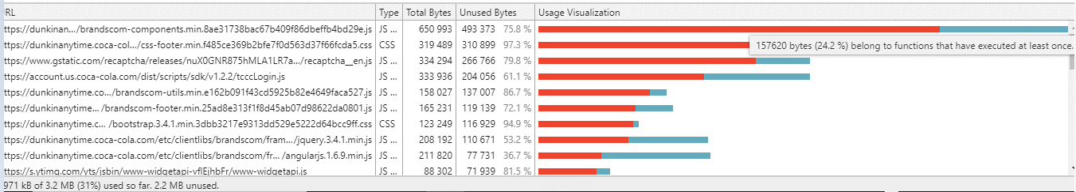
Recommendations
Remove Unused Code
Tool: Chrome Coverage Tab.
There are almost 75 to 97% unused bytes in JS and CSS codes.

Slide 20
Recommendations
Remove Unused Code
Consider removing JavaScript that is not used to reduce the page weight and load time.
URL | Transfer Size
https://dunkinanytime.coca-cola.com/etc/clientlibs/brandscom/brandscom-components.min.8ae31738bac67b409f86dbeffb4bd29e.js | 183.1 KB
https://www.gstatic.com/recaptcha/releases/nuX0GNR875hMLA1LR7ayD9tc/recaptcha__en.js | 128.5 KB
https://account.us.coca-cola.com/dist/scripts/sdk/v1.2.2/tcccLogin.js | 102.8 KB
https://dunkinanytime.coca-cola.com/etc/clientlibs/brandscom/brandscom-utils.min.e162b091f43cd5925b82e4649faca527.js | 46.9 KB
https://dunkinanytime.coca-cola.com/etc/clientlibs/brandscom/frameworks/jquery.3.4.1.min.js | 66.3 KB
https://dunkinanytime.coca-cola.com/etc/clientlibs/brandscom/brandscom-footer.min.25ad8e313f1f8d45ab07d98622da0801.js | 46.6 KB
https://dunkinanytime.coca-cola.com/etc/clientlibs/brandscom/frameworks/angularjs.1.6.9.min.js | 70.3 KB
https://s.ytimg.com/yts/jsbin/www-widgetapi-vflX_vK2f/www-widgetapi.js | 30.5 KB

Slide 21
Recommendations
Optimize and Deliver Images in Next Gen format: Consider delivering images in formats like WebP, JPEG 2000, and JPEG XR as they can provide better compression than PNG or JPEG, which can reduce the page weight, load time, and save server resources.
URL | Transfer Size
https://dunkinanytime.coca-cola.com/content/dam/dunkin/2018refresh/dunkinAnytime_home_hero_desktop.jpg | 149.4 KB
https://dunkinanytime.coca-cola.com/content/dam/dunkin/2018refresh/dunkinAnytime_home_tile1_bg_mobile.jpg | 46.2 KB
https://dunkinanytime.coca-cola.com/content/dam/dunkin/2019-refresh/IcedCoffee_4Pack.png | 39.8 KB
https://cocacola.scene7.com/is/image/cocacola/coldbrew_background?wid=562&fmt=png-alpha | 33.3 KB
https://cocacola.scene7.com/is/image/cocacola/multiserve_background_desktop?wid=562&fmt=png-alpha | 22.5 KB
https://dunkinanytime.coca-cola.com/content/dam/dunkin/2019-refresh/ColdBrew_CaramelBlack.png | 20.7 KB
https://dunkinanytime.coca-cola.com/content/dam/dunkin/2019-refresh/ColdBrew_MidnightBlack.png | 20.4 KB
https://cocacola.scene7.com/is/image/cocacola/product_lineup_desktop?wid=1132&fmt=png-alpha | 70.6 KB
https://dunkinanytime.coca-cola.com/content/dam/dunkin/2019-refresh/2020/desktop/multiserve_desktop.png | 50.5 KB

Slide 22
Thank You

